Slide 1
CS310 Operating Systems Lecture 9: Syscall exec*() Dual Mode of Operation – Part 1
Ravi Mittal
IIT Goa

Slide 2
Acknowledgements !
Contents of this class presentation has been taken from various sources. Thanks are due to the original content creators:
Class presentation: University of California, Berkeley: David Culler, Anthony D. Joseph, John Kubiatowicz, AJ Shankar, George Necula, Alex Aiken, Eric Brewer, Ras Bodik, Ion Stoica, Doug Tygar, and David Wagner
Operating Systems: Three Easy Pieces, by Remzi and Andrea Arpaci-Dusseau,
Chapter 5: Process APIs
Programs are taken from this chapter
CS 423 Operating System Design, Uinv of Illinois, Prof Fagen-Ullmschneider
CS351 University of Washington

Slide 3
Read the following:
Book: Operating Systems: Principles and Practice (2nd Edition) Anderson and Dahlin
Volume 1, Kernel and Processes
Chapter 2.2: Dual Mode of Operation
Operating Systems: Three Easy Pieces, by Remzi and Andrea Arpaci-Dusseau,
Chapter 5: Process APIs

Slide 4
We will study..
Process – Last class, exec*() syscall example
Dual Mode of Operation
Hardware support for dual mode operation
Mode Transfer: User to kernel - Introduction

Slide 5
Read the following:
Operating Systems: Principles and Practice (2nd Edition) Anderson and Dahlin
Volume 1, Concurrency
Chapter 2: Kernel Abstraction

Slide 6
Previous Classes..

Slide 7
Four Fundamental OS Concepts
Thread: Execution Context
Fully describes program state
Address space
Set of memory addresses accessible to program (for read or write)
Process: an instance of a running program
Protected Address Space + One or more Threads
Dual mode operation / Protection
Only the “system” has the ability to access certain resources
Done
Prof. John Kubiatowicz, CS 162, Operating Systems, UCB

Slide 8
Last Class: Process Syscalls: fork() exit, wait, exec*()

Slide 9
Process Related System Calls (in Unix)
fork() creates a new child process
All processes are created by forking from a parent
The init process is ancestor of all processes
exec() makes a process execute a given executable
exit() terminates a process
wait() causes a parent to block until child terminates
Last class

Slide 10
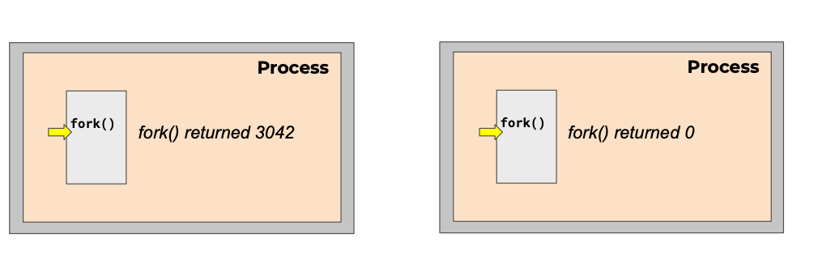
Creating a process
Just one process – Parent process
Initially there is one process – init with id = 1
pid = 1
pid = 3042
ppid() = 1
CS 423 Operating System Design, Uinv of Illinois, Prof Fagen-Ullmschneider

Slide 11
Waiting for children to die with wait()
The parent can wait for the child to die by executing the wait system call
It is quite useful for a parent to wait for a child process to finish what it has been doing
on success, returns the process ID of the terminated child; on error, -1 is returned.

Slide 12
Wait(): Synchronizing with Children
int wait(int *child_status)
Suspends current process (i.e. the parent) until one of its children terminates
Return value is the PID of the child process that terminated
On successful return, the child process is reaped
If child_status != NULL, then the *child_status value indicates why the child process terminated
Special macros for interpreting this status – see man wait(2)
When a child process terminates, wait stores the termination status of the terminated child (the value returned by main) into variable status, and returns the process number of the terminated child process
Null: Status value will not be stored
Notes:
child_status shouldn’t be examined directly – it should be examined using the macros WIFEXITED(), WEXITSTATUS(), etc. (see wait(2)).

Slide 13
exec() system call
The exec family of system calls replaces the program executed by a process
When a process calls exec, all code (text) and data in the process is lost and replaced with the executable of the new program
All open file descriptors remains open after calling exec
unless explicitly set to close-on-exec

Slide 14
p3.c
#include <unistd.h>
#include <string.h>
#include <sys/wait.h>
int
main(int argc, char *argv[])
{
printf("hello world (pid:%d)\n", (int) getpid());
int rc = fork();
if (rc < 0) {
// fork failed; exit
fprintf(stderr, "fork failed\n");
exit(1);
} else if (rc == 0) {
// child (new process)
printf("hello, I am child (pid:%d)\n", (int) getpid());
char *myargs[3];
myargs[0] = strdup("wc"); // program: "wc" (word count)
myargs[1] = strdup("p3.c"); // argument: file to count
myargs[2] = NULL; // marks end of array
execvp(myargs[0], myargs); // runs word count
printf("this shouldn't print out");
} else {
// parent goes down this path (original process)
int wc = wait(NULL);
printf("hello, I am parent of %d (wc:%d) (pid:%d)\n",
rc, wc, (int) getpid());
}
return 0;
}

Slide 15
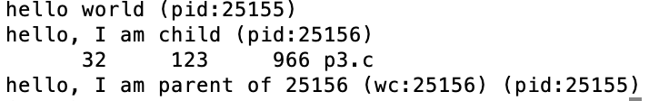
Program Output

Slide 16
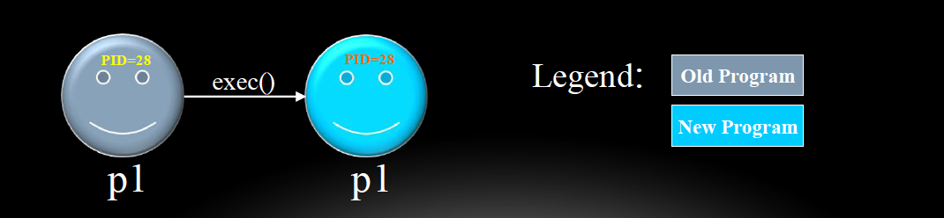
exec() – more information
Upon success, exec() never returns to the caller
A successful exec replaces the current process image, so it cannot return anything to the program that made the call
If it does return, it means the call failed. Typical reasons are: non-existent file (bad path) or bad permissions
As a new process is not created, the process identifier (PID) does not change
However, machine code, data, heap, and stack of the process are replaced by those of the new program

Slide 17
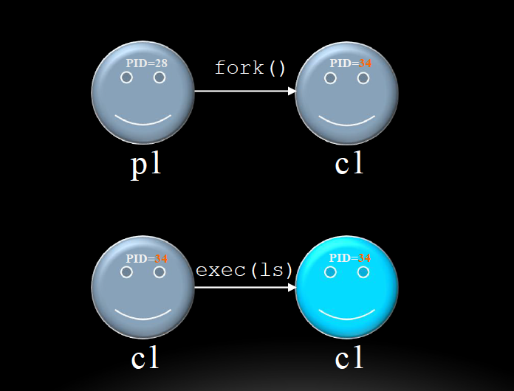
fork() and exec() combined
Often after doing fork() we want to load a new program into the child

Slide 18
Zombies
A terminated process still consumes system resources
Various tables maintained by OS
Called a “zombie” (a living corpse, half alive and half dead)
Reaping is performed by parent on terminated child
Parent is given exit status information and kernel then deletes zombie child process
What if parent doesn’t reap?
If any parent terminates without reaping a child, then the orphaned child will be reaped by init process (pid of 1)
Note: on recent Linux systems, init has been renamed systemd
In long-running processes (e.g. shells, servers) we need explicit reaping

Slide 19
Zombie State
Why keep process descriptor around?
Parent may be waiting for child to terminate
via the wait() system call
Parent needs to get the exit code of the child
If descriptor was destroyed immediately, this information could not be gotten
After getting this information, the process descriptor (or PCB) can be removed
no more remnants of the process

Slide 20
Process Summary
fork makes two copies of the same process (parent & child)
Returns different values to the two processes
exec* replaces current process from file (new program)
Runs two different programs:
First fork()
if (pid == 0) { execv(…) } else { /* parent code */ }
wait or waitpid used to synchronize parent/child execution and to reap child process

Slide 21
Four Fundamental OS Concepts
Thread: Execution Context
Fully describes program state
Address space
Set of memory addresses accessible to program (for read or write)
Process: an instance of a running program
Protected Address Space + One or more Threads
Dual mode operation / Protection
Only the “system” has the ability to access certain resources
Done
Next
Prof. John Kubiatowicz, CS 162, Operating Systems, UCB

Slide 22
Break (10 mins)

Slide 23
Four Fundamental OS Concepts
Thread: Execution Context
Fully describes program state
Address space
Set of memory addresses accessible to program (for read or write)
Process: an instance of a running program
Protected Address Space + One or more Threads
Dual mode operation / Protection
Only the “system” has the ability to access certain resources
Done
Prof. John Kubiatowicz, CS 162, Operating Systems, UCB

Slide 24
Dual Mode of Operation

Slide 25
Fourth OS Concept: Dual Mode Operation
Hardware provides at least two modes:
Kernel mode (or supervisor/protected)
User mode: Normal programs executed
Kernel mode
Execution with the full privileges of the hardware
Read/write to any memory, access any I/O device, read/write any disk sector, send/read any packet
User mode
Limited privileges
Prof. John Kubiatowicz, CS 162, Operating Systems, UCB

Slide 26
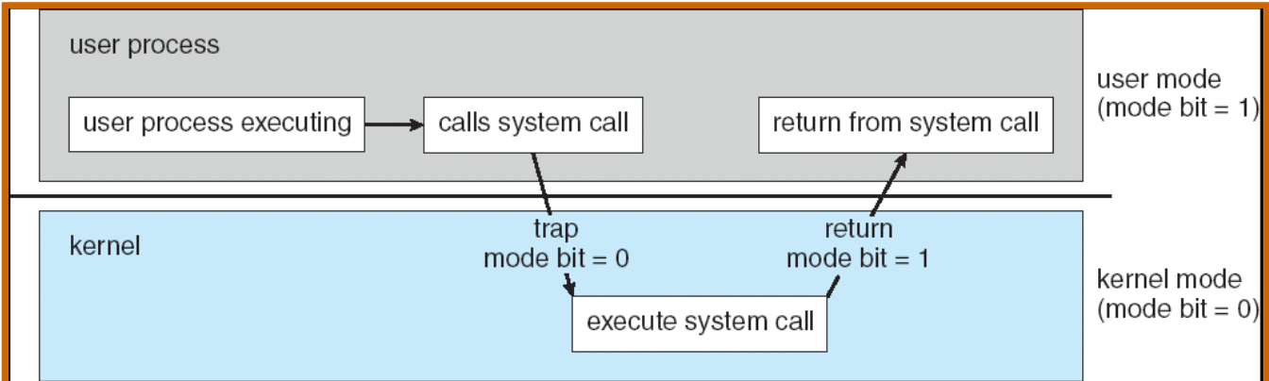
Dual Mode Operation
Certain operations are prohibited when running in user mode
Transitions between user mode and kernel mode are carefully controlled
Mode bit in processor determines if system is in User mode or Kernel mode
Book: The Operating System Concepts: Silberschatz, Galvin, Gagne

Slide 27
Dual Mode Operation
In user mode, the processor checks every instruction before executing it to verify that it is permitted by the process to be performed
What is needed in the hardware to support dual mode operation?
A bit of state (user/system mode bit)
Certain operations / actions only permitted in system/kernel mode
In user mode they fail or trap
User → Kernel transition sets system/kernel mode AND saves the user PC
Operating system code carefully puts aside user state then performs the necessary operations
Kernel → User transition clears system/kernel mode AND restores appropriate user PC
Example: return-from-interrupt
Aside: In RISC-V, where is this user/system mode bit ?

Slide 28
Mode bit
Mode bit : one bit register
Kernel mode: Mode bit = 1
Processor is in kernel mode and it can do anything
User mode: Mode bit = 0
Processor is in user mode and it is restricted
Where is this bit in the processor?
Processor Status Register (x86)
PSR contains flags that control processor’s operation
Flags are set and reset as a by-product of executing instructions
Not accessible to applications
CPSR: Current Program Status Register (ARM Architecture)

Slide 29
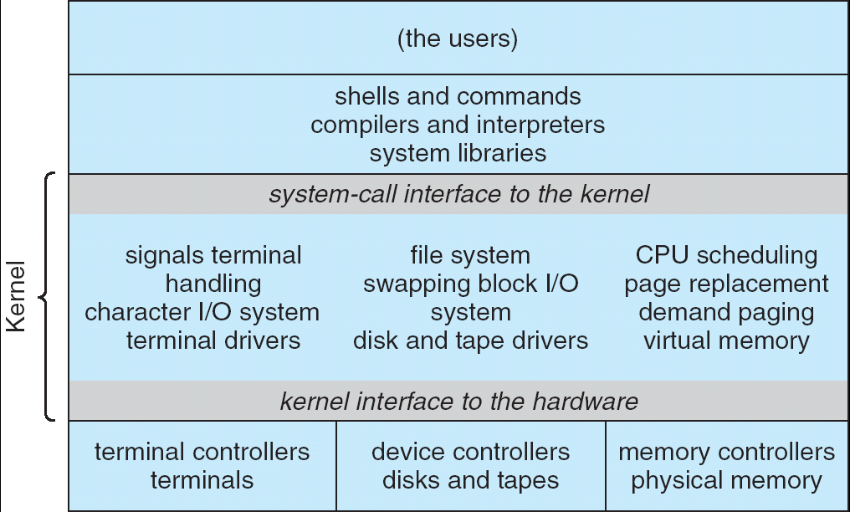
For example: UNIX System Structure
Applications
User Mode
Standard Libs
Kernel Mode
Hardware
Monolithic Architecture
Book: The Operating System Concepts: Silberschatz, Galvin, Gagne

Slide 30
User/Kernel (Privileged) Mode
User Mode
interrupt
exception
syscall
rtn
rfi
Kernel Mode
exit
exec
Limited HW access
Full HW access
rfi : return from Interrupt
Prof. John Kubiatowicz, CS 162, Operating Systems, UCB

Slide 31
Hardware Support for Dual Mode Operation

Slide 32
Hardware Support: Dual-Mode Operation
Privileged instructions
Available to kernel
Not available to user code
Limits on memory accesses
In user mode, all memory accesses outside of a process’s valid memory region must be prohibited
Prevent user code from overwriting the kernel
Timer Interrupts
Processor must have a way to regain control from a user program in a loop
Book: OS Principles and Practices: Anderson and Dahlin

Slide 33
Hardware Support: Dual-Mode Operation
Privileged instructions
Available to kernel
Not available to user code
Limits on memory accesses
In user mode, all memory accesses outside of a process’s valid memory region must be prohibited
Prevent user code from overwriting the kernel
Timer Interrupts
Processor must have a way to regain control from a user program in a loop
Book: OS Principles and Practices: Anderson and Dahlin

Slide 34
Privileged instructions
Application programs can use only a subset of the full instruction set
The operating system executes in kernel mode with the full power of the hardware
Privileged Instructions: Instructions available in kernel mode, but not in user mode
I/O instructions and Halt instructions
Turn off all Interrupts
Set the Timer
Context Switching
Clear the Memory or Remove a process from the Memory
Modify entries in the Device-status table
If an application in user mode attempts to access restricted memory, processor exception occurs → Kernel mode → Exceptional handler
Notes:
Change mode bit in EFLAGs register!
Change which memory locations a user program can access
Send commands to I/O devices
Read data from/write data to I/O devices
Jump into kernel code
…

Slide 35
Hardware Support: Dual-Mode Operation
Privileged instructions
Available to kernel
Not available to user code
Limits on memory accesses (Memory Protection)
In user mode, all memory accesses outside of a process’s valid memory region must be prohibited
Prevent user code from overwriting the kernel
Timer Interrupts
Processor must have a way to regain control from a user program in a loop
Book: OS Principles and Practices: Anderson and Dahlin

Slide 36
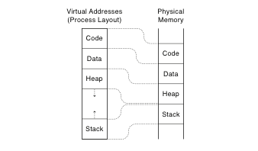
Memory Protection
OS must configure the hardware so that each application process can read and write only its own memory
Not the memory of other App or OS
Approaches
Base and Bound
Virtual Address – Address space
Virtual Address
Translation done in hardware, using a table
Table set up by operating system kernel

Slide 37
Base and Bound
0000…
Code
Static Data
Heap
Original Program
Stack
0000…
Base Address
code
0010…
1000…
Code
1000…
Static Data
Program
address
0010…
Static Data
heap
1010…
Heap
<
stack
0100…
Bound
Stack
0100…
1100…
FFFF…

Slide 38
Base and Bound
Two extra registers: base and bound
Can be set only by OS
Base register
Specifies the start of the process’s memory region in physical memory
Bound Register
Gives the end point of of the process’s memory region in physical memory
Book: OS Principles and Practices: Anderson and Dahlin

Slide 39
Base and Bound - Limitations
Two extra comparison for each instruction
Contiguous memory location is needed to keep process image
Difficult to manage growth of Heap and Stack (in opposite direction)
No possible to share memory between two processes
Memory fragmentation
Relocation is hard – Entire memory image is to be located
Book: OS Principles and Practices: Anderson and Dahlin

Slide 40
Virtual Memory – Paging
We have studied Paged Virtual Memory in detail – CA course
All modern OS use this mechanism
Paged Virtual Memory has many advantages
Instructions operate on virtual addresses
Translated at runtime to physical addresses via a page table
This allows relocation of pages at physical memory – Easily
Enormous amount of flexibility to manage physical memory
It allows the heap and the stack start at separate ends of the virtual address space
they can grow according to program needs
Higher Efficiency with the use of Page Tables, TLBs etc
Protection and Security
Sharing possible

Slide 41
Hardware Support: Dual-Mode Operation
Privileged instructions
Available to kernel
Not available to user code
Limits on memory accesses
In user mode, all memory accesses outside of a process’s valid memory region must be prohibited
Prevent user code from overwriting the kernel
Timer Interrupts
Processor must have a way to regain control from a user program in a loop
Book: OS Principles and Practices: Anderson and Dahlin

Slide 42
Hardware Timer
All computer systems include a device – Hardware timer
Hardware timer periodically interrupts the processor
Returns control to the kernel handler
Interrupt frequency set by the kernel
Not by user code!
Interrupts can be temporarily deferred
Not by user code!
Interrupt deferral crucial for implementing mutual exclusion
Will study it later (Mutual Exclusion implementation topic)
Each processor has a separate timer
Notes:
How do I stop a runaway program? How do I know if a runaway program needs to be stopped, or its just taking a long time?

Slide 43
Timer based mode switch
For giving chance to multiple processes to run on CPU
Hardware must provide a way for the OS kernel to periodically regain control of the processor
Example:
OS starts a user level process
User process is free to run any user level instructions it wants, call any function in process’s memory region, and load/store any value in it’s memory
Does User process have complete control of the hardware forever?
To break infinite loop of the application, OS must take control

Slide 44
Helping Kernel to gain control
How does the kernel know if an application is in an infinite loop?
Kernel doesn’t know it
Then would OS kill process after gaining control ?
No
It doesn’t know ; May be this is intended functionality
Then.. What ?
It terminates the process when requested by the user or system administrator

Slide 45
Mode Transfer: User to Kernel

Slide 46
User to Kernel mode Transfer
User Mode
interrupt
exception
syscall
rtn
rfi
Kernel Mode
exit
exec
Limited HW access
Full HW access

Slide 47
User → Kernel Mode Transfer
System Call (syscalls)
User Process requests a system service
Open or delete a file, read/write data into files, create a new user process, establish a connection to web server etc
Interrupt
External asynchronous event, independent of the process
e.g., Timer, I/O device
Processor Exception (trap)
Hardware event caused by user program behavior that causes context switch
E.g., Divide by zero, bad memory access (segmentation fault)

Slide 48
Dual Mode: Summary
Most of OS kernels support dual mode of operation
User Mode
Kernel Mode
A single bit called Mode bit is set by hardware that defines if the mode is user or kernel
Dual mode operation is implemented with the support of
Privileged Instructions – that Kernel executes
Limits on Memory Protection
Use of Timer Interrupts

Slide 49
Backup

Slide 50
Mode Transfer: User to Kernel -
Synchronous Exception

Slide 51
System Calls
Each x86-64 system call has a unique ID number
Examples:
Number | Name | Description
0 | read | Read file
1 | write | Write file
2 | open | Open file
3 | close | Close file
4 | stat | Get info about file
57 | fork | Create process
59 | execve | Execute a program
60 | _exit | Terminate process
62 | kill | Send signal to process

Slide 52
Mode Transfer: User to Kernel -
Interrupt (asynchronous Exception)

Slide 53
Interrupts (Asynchronous Exception)
An asynchronous signal to the processor
Some external event requires processor’s attention
Indicated by setting the processor’s interrupt pin
Processor stalls or completes existing instruction that is in progress; Saves current execution state; Starts execution of specially designated interrupt handler in the kernel
Each different type of interrupt requires its own handler
Example:
Timer Interrupt: Every few ms; an external timer chip triggers an interrupt ; Timer handler can switch execution to different process
I/O interrupt eg from mouse, keyboard, disk, Ethernet, WiFi, Flash drive, Inter-processor interrupts, DMA, arrival of a packet from a disk
Inter-processor Interrupt: For inter processor communication

Slide 54
Processor Exceptions
A hardware event caused by user program behavior
Causes transfer of control to the Kernel
Processor saves the current execution state and runs specially designated exception handler in the kernel
Example:
User process attempts to execute a privileged instruction
User process tries to access memory out of it’s own memory region
Process divides an integer by zero
Process attempts to write to read-only memory
A benign event: setting up a breakpoint
Processor exceptions are used effectively to emulate VMs

Slide 55
Lecture Summary
The four important concepts of Operating Systems include
Thread
Address Space
Process
Dual mode of operation / Protection

Slide 56
Exceptions cause Mode Transfer
Syscall
Process requests a system service, e.g., exit
Like a function call, but “outside” the process
Does not have the address of the system function to call
Like a Remote Procedure Call (RPC) – for later
Marshall the syscall id and args in registers and exec syscall
Trap or Exception
Internal synchronous event in process triggers context switch
e.g., Protection violation (segmentation fault), Divide by zero, …
Interrupt
External asynchronous event triggers context switch
e. g., Timer, I/O device
Independent of user process

Slide 57
x86 – segments and stacks
Processor Registers
code
static data
CS
EIP
heap
SS
ESP
EAX
stack
DS
EBX
ES
ECX
CS:
code
EDX
EIP:
ESI
EDI
static data
Start address, length and access rights associated with each segment register
heap
SS:
ESP:
stack

Slide 58
How does the OS kernel prevent a process from harming another process ?
When there are multiple programs in Main Memory
What prevents a process from overwriting another process’s data structures, or
Overwriting the OS image stored on disk?
Recall RISC-V instructions
Most instructions such add, sub etc are perfectly safe
How can we allow them to execute directly on hardware?
We implement as simple check in hardware called dual-mode operation
Represented by a single bit in the processor status register that signifies the current mode of the processor

